Slide 1
Process Control
Course II
Lecture 12
Process Control Loops
Part II
By
Prof. Alaa Kareem Mohammed

Slide 2
Type of Process Control Loop
1- Feedback Control
2- Feedforward Control
3- Feedforward-plus-Feedback Control
4- Ratio Control
5- Cascade Control
6- Split Range Control

Slide 3
1- Feedback Control
Process: Heating tank CSTH
$$T_{o}=f(m, T_{i}, Q)$$
Controlled variable : To
Manipulating variable: Q:
Set point
TRC
TI
T T
m T_{i}
T E
M
m ,T_{o}
Steam in
Q

Slide 4
A feedback loop measures a process variable and sends the measurement to a controller for comparison to set point. If the process variable is not at set point, control action is taken to return the process variable to set point. This control scheme does not take into consideration any of the other variables in the process
Advantages :
1- One of the simplest process control schemes.
2- It is commonly used in the process control industry.
3- It is that directly controls the desired process variable
Disadvantage :
The disadvantage of feedback loops is that it takes some time in order that the controlled variable reaches the set point.

Slide 5
Example 1
Consider the liquid level tank shown below. Draw a feedback control loop to control the liquid level inside the tank (h). The control loop should contains the following :
1- Measuring element
2- Transmitter.
3- Indicator (function in DCS)
4- Recording controlling (front mounted in remote panel)
5- Pneumatic control valve.
6- Give tag No. for these items
$$q_{i}$$
h
$$R$$
$$q_{o}$$

Slide 6
Solution
Set point
LRC
LI
LT
$$41201$$
$$41201$$
$$41201$$
$$q_{i}$$
LE
$$41201$$
h
$$R$$
$$q_{o}$$

Slide 7
Homework 1
Consider the heating tank system below.
Construct two feedback control loops on the system according to the following description:
First control loop:
Controlled variable : To
Manipulating variable : Q
m T_{i}
Second control loop:
Controlled variable : h
Manipulating variable : m
h
m ,T_{o}
Steam in
Q

Slide 8
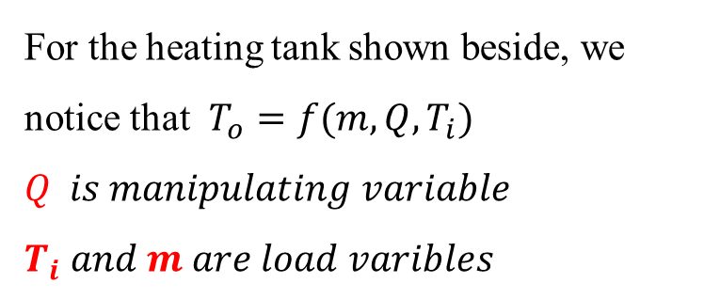
2- Feedforward Control
Feedforward loop is a control system that anticipates load disturbances and controls them before they can impact the process variable. For feedforward control to work, the user must have a mathematical understanding of how the manipulated variables will impact the process variable.
m T_{i}
For the heating tank shown beside, we notice that $T_{o}=f(m,Q, T_{i})$
$$Q is manipulating variable$$
$$T_{i} and m are load varibles$$
h
m ,T_{o}
In feedforward control, the controlled variable will be controlled through the load variables only
Steam in
Q

Slide 9
F T
FIC
Set point
F E
m
T_{i}
T E
Set point
h
T T
TIC
m ,T_{o}
Steam in
Q

Slide 10
An advantage of feedforward control is that error is prevented, rather than corrected. Feedforward scheme is better than feedback control scheme in that it takes no time to manipulate the controlled variable when the system is subjected to a disturbance. The difficulty that face the feedforward loop is that it should take into account all the possible load disturbances in a system , but this is either difficult or costly.

Slide 11
Example 2
Consider the liquid level tank shown below. Draw a feedforward control loop to control the liquid level inside the tank (h). Knowing that $h=f(q_{i})$. The control loop should contains the following :
1- Measuring element
2- Transmitter.
3- Indicator rear mounted on local panel.
4- Recording controlling (field mounted)
5- Pneumatic control valve.
$$q_{i}$$
h
$$R$$
$$q_{o}$$

Slide 12
Solution
FI
FT
$$h=f( q_{i})$$
FRC
Set point
FE
$$q_{i}$$
h
$$R$$
$$q_{o}$$

Slide 13
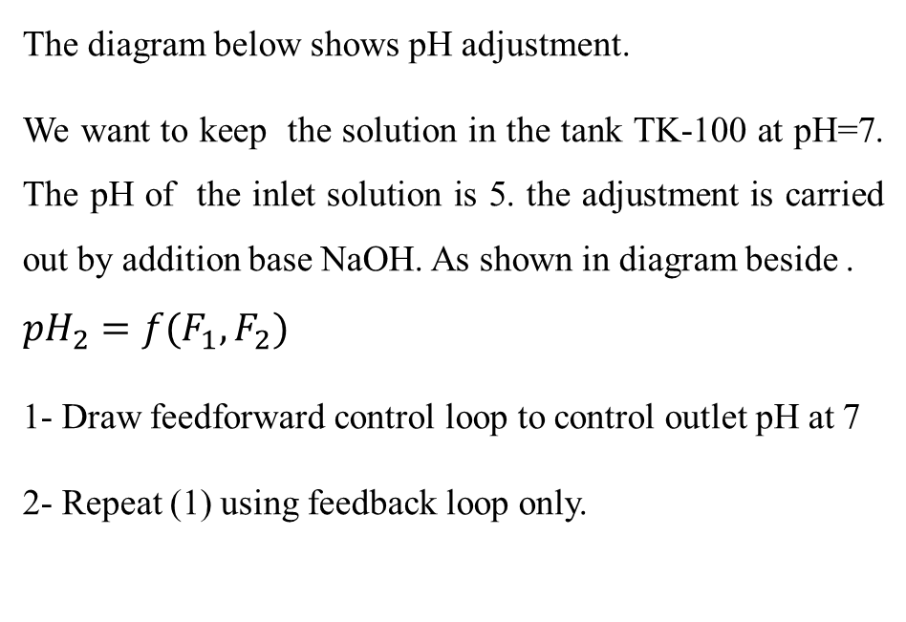
Example 3
Base tank
The diagram below shows pH adjustment.
We want to keep the solution in the tank TK-100 at pH=7. The pH of the inlet solution is 5. the adjustment is carried out by addition base NaOH. As shown in diagram beside .
$${pH}_{2}=f(F_{1},F_{2})$$
1- Draw feedforward control loop to control outlet pH at 7
2- Repeat (1) using feedback loop only.
TK-101
NaOH
F2
F1
Inlet solution
pH1
TK-100
F3
outlet solution
pH adjustment tank
pH2

Slide 14
Solution
Base tank
Set point
1 - Feedforward loop
TK-101
$${pH}_{2}=f(F_{1},F_{2})$$
F IC
NaOH
F T
F2 is manipulating variable
F1 is load variable
F E
F2
F1
Inlet solution
pH1=5
TK-100
F3
outlet solution
pH adjustment tank
pH2

Slide 15
Base tank
- Feedback loop
TK-101
NaOH
F2
pH IC
Set point
F1
pH T
Inlet solution
pH1=5
pH E
TK-100
F3
outlet solution
pH2

Slide 16
3- Feedforward-plus-Feedback Control
It is a combined system which consists of two loops feedforward and feedback loops. It is used when the controlled variable is function of many variables, so it is difficult to take account for every possible load disturbance. Feedforward is used for the load disturbance which has great effect on controlled variable. Feedback loop is used for controlled variable.
Controller with summing functions are used in these combined systems to total the input from both the feedforward loop and the feedback loop, and send a unified signal to the final control element.

Slide 17
Example 4
Consider the heating vessel below . The temperature of the outlet stream T3 is function of many variables
$$T_{3}=f(m_{1},m_{2},Q,T_{1}, T_{2})$$
m₂ T₂
m₁ T₁
Inlet flowrate m₁ is more effective on the controlled variable T₃
Use feedforward –pulse - feedback loop to control the temperature of outlet stream T₃.
h
m₃ T₃
Steam in
Q

Slide 18
Solution
F T
FIC
Set point
F E
m₂ T₂
m_{1,}T₁
m₃ ,T₃
Steam in
Set point
T E
Q
TIC
T T

Slide 19
Another solution
FIC
Σ
F T
Set point
TIC
Set point
F E
m₂ T₂
T T
m_{1,}T₁
T E
m₃ ,T₃
Steam in
Q

Slide 20
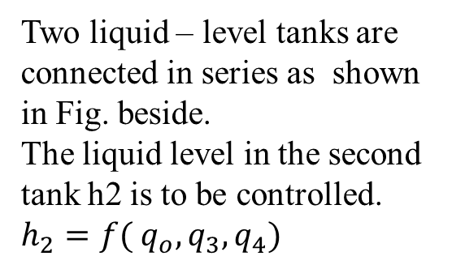
Homework 2
Two liquid – level tanks are connected in series as shown in Fig. beside.
The liquid level in the second tank h2 is to be controlled.
$$h_{2}=f( q_{o},q_{3}, q_{4})$$
q_{o}
q₃
h1
q₁
q₄
Construct control loop to control h₂ using:
1- Feedforward loop
2- Feedback loop
3- Feedforward-plus-feedback.
R1
TK101
q₂
h2
R2
TK102

Slide 21
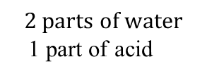
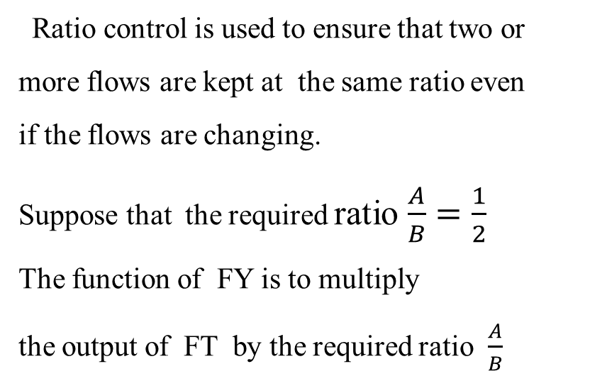
4- Ratio Control
This unit multiplies (B) by the desired ratio; so the output=$B∗\frac{A}{B} =A$
Ratio control is used to ensure that two or
more flows are kept at the same ratio even
if the flows are changing.
Suppose that the required ratio $\frac{A}{B}=\frac{1}{2}$
The function of FY is to multiply
the output of FT by the required ratio $\frac{A}{B}$
B
A
F T
F Y
FIC
F T
F E
F E
Ratio set point
$$B$$
$$A$$
$$Water$$
A$cid$
The result is A , this result is used as the set point to the controller FC
$$2 parts of water$$
1 part of acid

Slide 22
Ratio control is applied in the following cases :
1- Blending two or more flows to produce a mixture with specified composition
2- Blending two or more flows to produce a mixture with specified physical properties.
3- Maintaining correct air and fuel mixture to combustion.
If the physical characteristic of the mixed flow is measured, a PID controller can be used to manipulate the ratio value For example, a measurement of the density, gasoline octane rating, color, or other characteristic could be used to control that characteristic by manipulating the ratio.

Slide 23
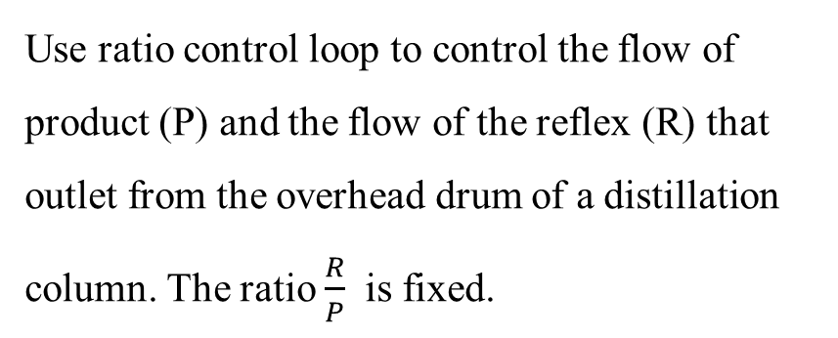
Example 5
Overhead vapor
Use ratio control loop to control the flow of product (P) and the flow of the reflex (R) that outlet from the overhead drum of a distillation column. The ratio $\frac{R}{P}$ is fixed.
Overhead drum
Reflex to column
Product
R
P

Slide 24
Solution
Overhead vapor
Condenser
Overhead drum
Product
R
P
Reflex to column
Ratio set point
FE
F E
FT
FY
FIC
FT

Slide 25
Ratio control for three streams
Suppose we have three streams A,B and C as shown in Figure below. The ratio of these streams are A:B:C= 1:2:10. Draw a control loop to adjust the mixed stream at the given ratio.
F E
FT
FIC
A
FE
FT
FIC
B
R
Mixer
Ratio set point $\frac{B}{C}$
FY2
A:B:C = 1:2:10
F E
FT
FY1
Ratio
set point
$$\frac{A}{C}$$
C

Slide 26
Homework 3
Use the Ratio control loop to adjust the ratio of fuel that inlet to the furnace as shown in Figure below.
A
Air
mixer
Furnace
B
Fuel

Slide 27
5- Cascade Control
Temperature controller primary
Flow controller secondary
Cascade control consists of two loops ; primary loop and secondary loop.
Primary loop is constructed on the variable to be controlled while the secondary loop is constructed on the manipulating variable.
Steam
mi, ti
Set point
F T
FIC
T C
T T
Consider the shell and tube heat exchanger in Fig. beside. Suppose we want to control the outlet temperature T₂ at a certain value by manipulating variable mi using cascade control.
T E
Fluid out T₂
Fluid in T₁
mo , to
27

Slide 28
Requirements for cascade control:
Secondary loop process dynamics must be at least four times as fast as primary loop process dynamics.
Secondary loop must have influence over the primary loop.
Secondary loop must be measured and controllable.

Slide 29
Example 6
Use cascade loop to control the level of the liquid inside the Tank in Figure below. Knowing that $h=f( q_{1}, q_{2})$. Use $q_{2}$ as manipulating variable. Repeat the solution if we use feedback loop only.
$$q_{1}$$
$$q_{2}$$
h

Slide 30
Solution
Cascade control loop
Set point
LI
LRC
$$q_{1}$$
LT
FT
FIC
LE
F E
h
$$q_{2}$$

Slide 31
Feedback control loop
LT
LI
LRC
Set point
$$q_{1}$$
LE
h
$$q_{2}$$

Slide 32
Homework 3
Figure below shows a jacketed reactor which carries out exothermic reaction. We want to control the reaction temperature T . The manipulating variable is the flowrate of the cooling water to the jacket(m).
1- use cascade control loop only
2- use feedback control loop only
3- use feedforward – pulse- feedback loop.
Reactants
T
Reactor
Cooling water
m kg/s
Product

Slide 33
5- Split Range Control
Spilt control loop is very common control scheme in which the output of a controller is split to two or more of control valves. In this case , one of the control valve is chosen normally closed and the other is chosen normally open. For example (Figure below)
FIC
FT
Valve A
Controller output 0% Valve A fully open and valve B fully closed
Controller output 25% Valve A is 75% open and valve B is 25% open
Valve B
Controller output 50 % Valve A is 50 % open and valve B is 50 % open
Controller output 75 % Valve A is 25 % open and valve B is 75 % open
Controller output 100 % Valve A is fully closed and valve B is fully open

Slide 34
Example 7
Base tank
Acid tank
The diagram below shows pH adjustment.
We want to keep the solution in the tank TK-100 at pH=6.
Use split range control loop to adjust the value of pH in the tank at 6 with the aid of the acid and base feeding tanks.
TK-102
TK-101
NaOH
H₂SO4
F1
Inlet solution
TK-100
F2
outlet solution
(pH adjustment tank)

Slide 35
Solution
Base tank
Acid tank
TK-102
TK-101
NaOH
H₂SO4
F1
Set point
pHC
Inlet solution
TK-100
pHI
pHT
pHE
F2
outlet solution
(pH adjustment tank)

Slide 36
Homework 4
Use split range control loop to control the pressure inside the overhead accumulator (shown below). When the pressure exceed the desired value , the line to flare will open so the outlet stream is divided into two stream ;one to flare and the other to process unit.
Flare
Overhead vapor
Process unit
P
Reflex to column
Overhead accumulator

Slide 37
Reward (2 marks)
Figure below shows a reactor for detergent production. The inlet liquids are in the ratio of A : B: C= 1: 3: 20
Construct a control system that consists of different loops to control the following output variables:
1- The liquid level inside the reactor (h)
2- The temperature (T) of the reaction mixture.
3- Keep the ratio of inlet feeds constant.
A
Sulfonic acid
B
Water
C
NaOH
Cooling water out
h
T
Reactor
Product (detergent)
Cooling water in

Slide 38
Ratio set point $\frac{A}{C}$
FE
FI
FRC
FY1
A
FT
Sulfonic acid
FY2
FE
FE
FI
FRC
Ratio set point $\frac{B}{C}$
Water
C
NaOH
B
LT
LIC
Set point
LE
Set point
TRC
TI
TE
h
T
Cooling water out
Cooling water in
Reactor
Product (detergent)

Slide 39
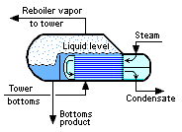
M (kg/h)
condenser
LE
LT
Distillation column
Overhead drum
LRC
set point
h1
R (kg/h)
1
Feed, F
2
FE
P (kg/h)
T_{F}
FRC
FT
FE
FY
FT
6
w (kg/h)
set point
TIC
TT
TE
Ratio set point $\frac{R}{P}$
S (kg/h)
N (kg/h)
h2
B (kg/h)
Feed, F
B (kg/h)
Σ
LRC
LT
LE
set point

Slide 40
Ratio set point $\frac{A}{B}$
FY1
Ratio set point $\frac{C}{B}$
FI
FRC
FT
FY2
FE
FE
Water
A
NaOH
B
FE
FRC
FE
C
Sulfonic acid
Σ
LIC
LT
LE
Set point
Cooling water out
pHC
pHT
pHE
h
T
Reactor
Product (detergent)
Set point
pH
Cooling water in
TIC
TI
TE
Set point

Slide 41
Thank you
Any ?

